Slide 1
A LIGHT WEIGHT APP TO WORK WITH DISCOURSE.ORG (METASTUDIO.ORG)
https://apptest.metastudio.org/

Slide 2
Agenda
01
AIM of the project
CHAT
02
Technical details
03
Results
04
Video tour of mobile app
05
Live Website tour
06
Future scope
07
Concluding remarks

Slide 3
Introduction
COOOL STEM GAMES
The COOOL STEM Games or the MetaStudio platform is inspired by project-based learning which is central to Gnowledge lab.
Learning Model
Constructionist and connectionist models of learning carried out by using Activity Based Collaborative Distributive (ABCD) moves.
Game and badges based learning
It is an online platform for discussion and rewards based on the STEM habits and was launched on 15th June, 2019.
Open source learning
It consists of collaborators seeking STEM discussions and hence, mainly concerned with open discussions and posting in threads.
.
Problems
The major drawback that was raised and complained about was the resource utilisation, heavy bandwidth consumption and the complexity of the website.

Slide 4

AIM Of The Project
Lighter
Responsive
Uses data and storage parsimoniously in order to shorten loading times. This will allow people from remote areas to access the website and still have the same user experience.
Adapts to all screen sizes making it cross platform supportive and thus more accessible to users.
App to mimic metastudio.org
Simpler
Progressive
A clean, intuitive and simple telegram like chat User Interface. Young students are also potential users, so making an easy to interact UI was a must.
Can be viewed offline as read-only because of cached webpages. Allows the app to be installed on all devices irrespective of the Operating System.

Slide 5
Technical Details
Mobile First approach to UI
Templating
Extras
Frontend kept very light
Pages made dynamic
AJAX asynchronous requests
HTML with EJS templating
EJS used
Quill editor for markdown
CSS enhanced with light weight Pure CSS
Server data simply plugged in
Manifest and service worker for pwa
Mostly Vanilla JavaScript
Gulp.js and Minification of code
Node.js
HTTPS TLS
Express.js
Session and Cookies to make seamless login
Discourse.org API
Obfuscated JS
AES 256 encryption and md5 Hashing
Backend
Security

Slide 6
Results
All the tests have been conducted in cache disabled modes.
As evident from these, the new site is light-weight and cuts down network and storage consumption as compared to main metastudio site by nearly 50%.
The number of requests per page is very less as compared to the existing version.
The loading time, resources used and the amount of data transfer on first-load are reduced.
We also tested our app on 3G, slow 3G and in various simulated conditions and displays, and it turned out to be way faster than the current version of metastudio.org.
Our app is far ahead of metastudio.org with its minimalistic approach.
98%
Less resources used
70%
Less cross website requests sent
57%
Less data consumed
50%
Faster than metastudio.org
0
Vulnerabilities

Slide 7
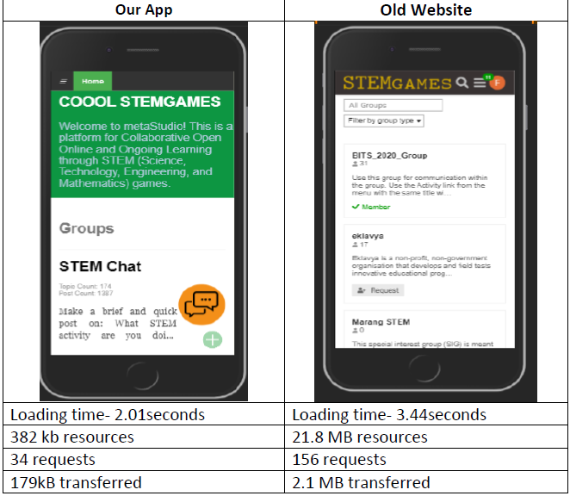
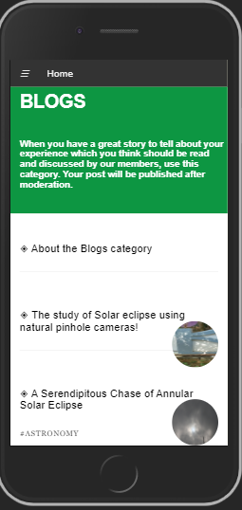
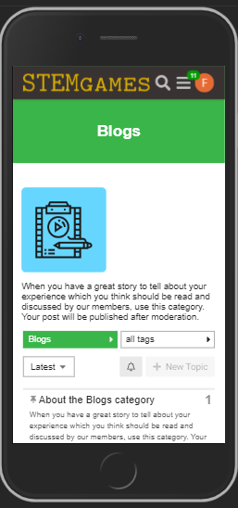
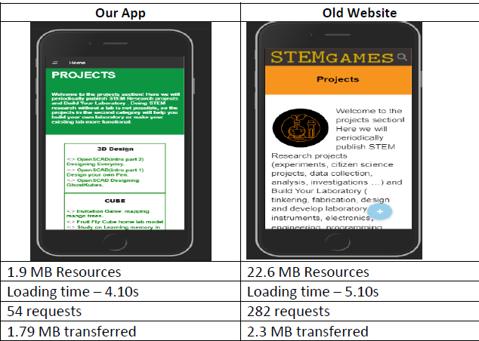
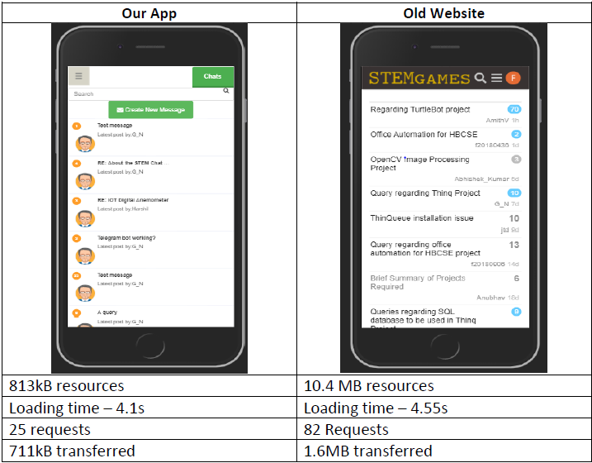
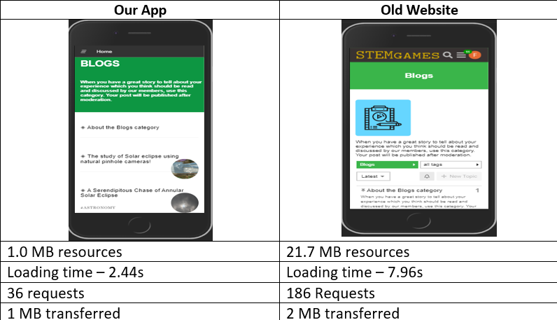
Groups page
Projects page
Chats
Page
Blogs
page

Slide 8
Future Scope
Adding math formula support to editor in order become a complete STEM platform.
Uploading media in compressed format with shareable URL links
To make conversations interesting and motivating
Adding sharing of posts and images feature
Making the app more like metastudio albeit having Telegram UI
Mathematical Formulas
Media upload
Post like and unlike
Sharing of Posts
Threaded Conversation

Slide 9
Concluding Remarks
PS1 brought new learning opportunities
This internship has been a unique and interesting experience. We have gained new technical knowledge and skills.
We got to learn and work in the domain of Web Development. This real-life problem statement and client needs introduced us to the world of software development.
We got insight into professional practices like working and collaborating in teams on GitHub.
This also taught us the art of addressing client needs, managing time and setting achievable targets
Presenting updates and reporting for meetings helped us gain important soft skills which are needed to work in any domain in life.
Working under excellent mentors
We are grateful to have knowledgeable and helpful mentors who guided us throughout this internship period.
We would like to express our deepest gratitude and special thanks to Professor Nagarjuna G, who despite being very busy with his duties, guided and kept us on the correct path.
We also express our deepest thanks to all the industry mentors, namely Surendra Sir, Mahesh Sir and Siddhu Sir for taking part in crucial decisions and for resolving the issues we faced.
Puneet Kishore sir helped us engineers see the world in a non-technical way. His insights are the reason this app is user friendly. It was a pleasure working with him.

Slide 10
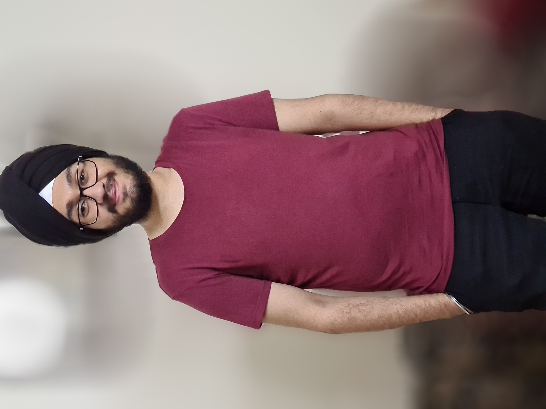
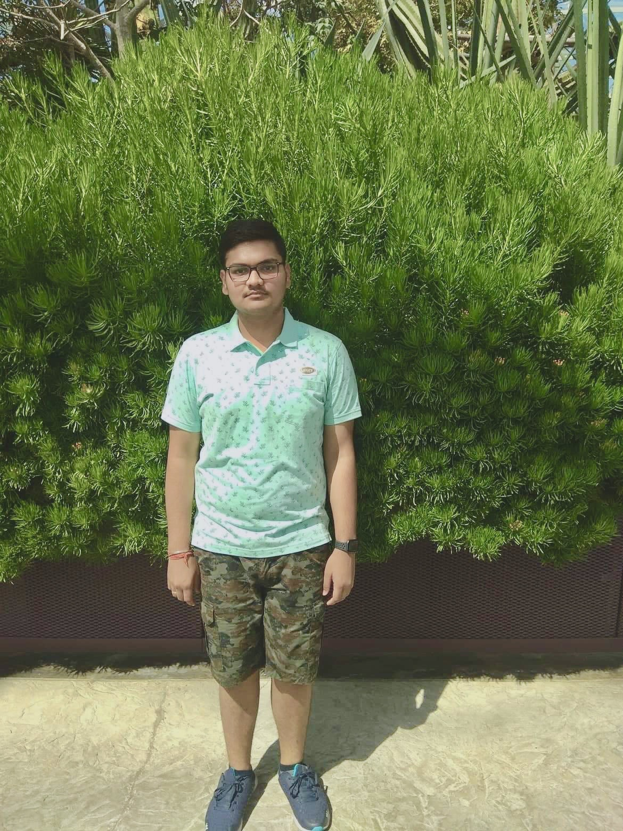
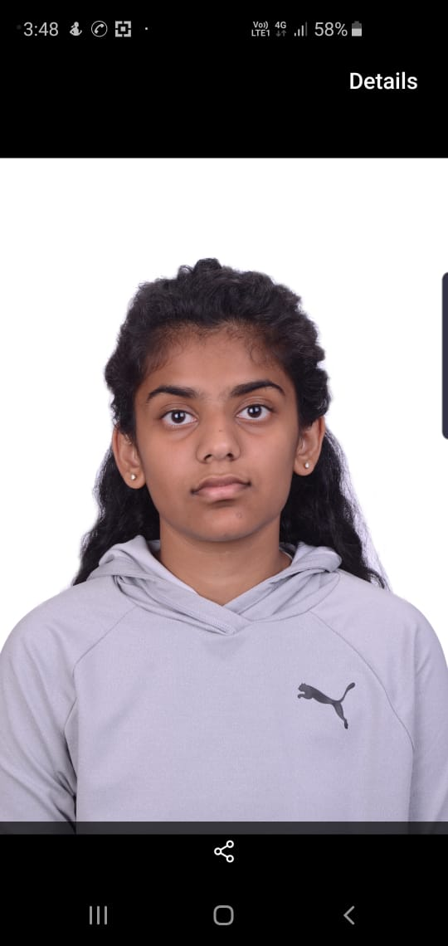
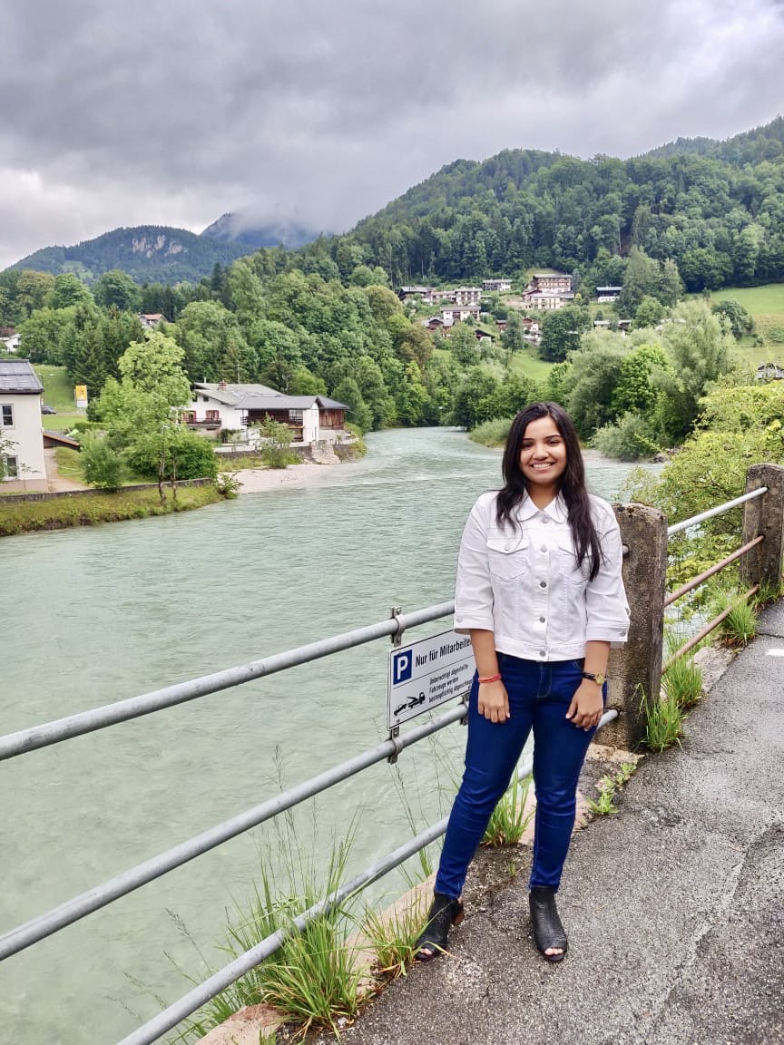
Our Team
Bir Anmol Singh
Shubham Agarwal
Ananya Khandelwal
Anusha Agarwal
B.E. Computer Science
B.E. Computer Science
B.E. Electronics and Instrumentation
B.E. Electrical and Electronics
f20180261@pilani.bits-pilani.ac.in
f20180301@pilani.bits-pilani.ac.in
f20180417@pilani.bits-pilani.ac.in
f20180032@hyderabad.bits-pilani.ac.in

Slide 11


